Slide 1
Molecular Simulations and Supercomputing/Parallel Computing
Fundamentals of Molecular Simulations
02/19/2020
Chowdhury M Ashraf

Slide 2
Outline
Overview of MD algorithm
Which parts can be done in parallel?
Which parts must be done serially?
What are CPUs/GPUs
Introduction to parallelization schemes
OpenMP – Multithreading
MPI – Message Passing Interface
How does this help us run MD?
Examples
Running MD in multiple parallel schemes
Tips on analyzing multiple files with bash

Slide 3
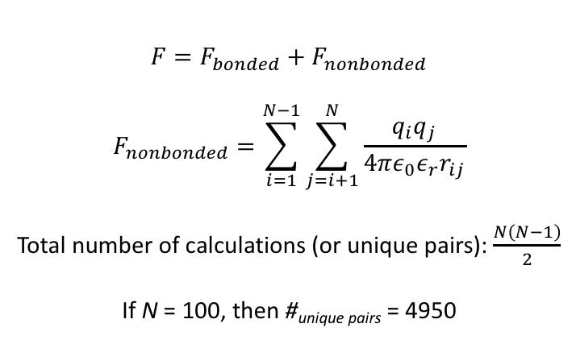
Molecular Dynamics Algorithm
$$F=F_{bonded}+F_{nonbonded}$$
$$F_{nonbonded}=\sum_{i=1}^{N−1}{\sum_{j=i+1}^{N}{\frac{q_{i}q_{j}}{4πε_{0}ε_{r}r_{ij}}}}$$
Total number of calculations (or unique pairs): $\frac{N\left(N−1\right)}{2}$
If N = 100, then #_{unique pairs} = 4950
There can be many calculations for even a small, simple, classical MD simulation!

Slide 4
Serial vs. Parallel Calculations in MD
Calculate all atomic positions for t + △t
Calculate a single atom’s position for t + △t
Calculate all non-bonded interactions
Calculate a single atom’s non-bonded interactions
Calculate all bonded interactions
Calculate a single atom’s bonded interactions
Parallel
Serial

Slide 5
What is a CPU? a GPU?
CPU: Central Processing Unit
Consists of multiple processors
Anywhere from 2 to >32 processors on a CPU
Myth: More cores = Better CPU
Must account for single-core performance!
GPU: Graphics Processing Unit
>1000 processors on a GPU
Each core is much slower than a core on a CPU
Good for parallel tasks because # of processors

Slide 6
Hyak Supercomputer
Ikt
16 cores / node
~64 GB RAM
65 nodes on Pfaendtner
64 nodes on STF
Going away in 2☹2☹
Mox
28 – 32 cores / node
128+ GB RAM
10 nodes (28 cores) and 11 nodes (40 cores) on Pfaendtner
92 nodes on STF
10 GPU nodes on STF

Slide 7
How do we parallelize code?
OpenMP – Multi-threading/ Multi-Processing
Creates multiple threads which contain a number of calculations that can be executed independently
Shared memory
Cannot thread beyond a single node (or computer)
MPI – Message Passing Interface
User defines number of MPI ranks, where each MPI rank is essentially a copy of the program that executes its portion of the code (e.g., summing a subset of the total data)
Allows for multiple nodes to communicate
High overhead and high memory
CUDA – Compute Unified Device Architecture
nVidia’s platform for parallelization across nVidia GPUs
Only useful for >1000 threads

Slide 8
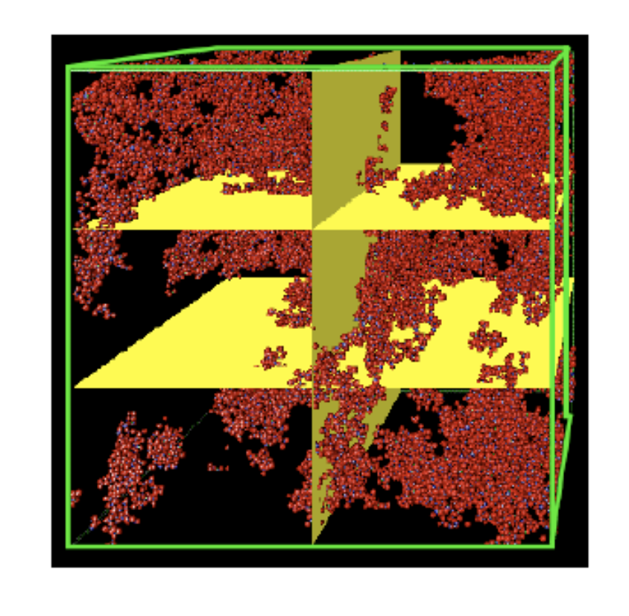
Parallelization
How can we speed up the calculation by using many CPUs in parallel?
Answer: partition the big simulation cell into many smaller ones and give each CPU a small piece to work on simultaneously.
This is called domain decomposition
Each CPU deals only with its local subregion
Must exchange information at boundaries via MPI
Works well for short range interactions that are local

Slide 9
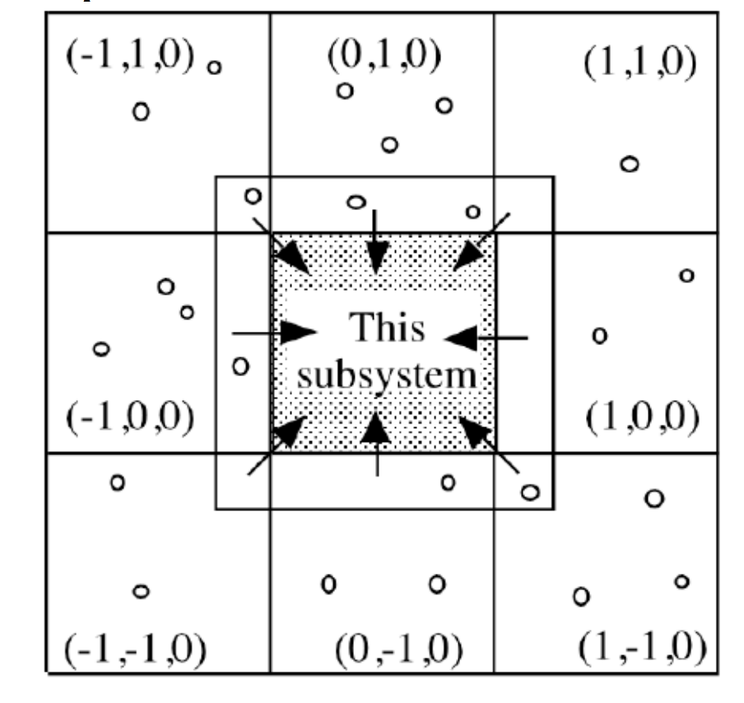
What do we need?
Each subsystem must know its neighboring domains.
Atom caching: each domain must not only know about its own atoms, but also about all atoms within interaction range from the boundary to compute the forces

Slide 10
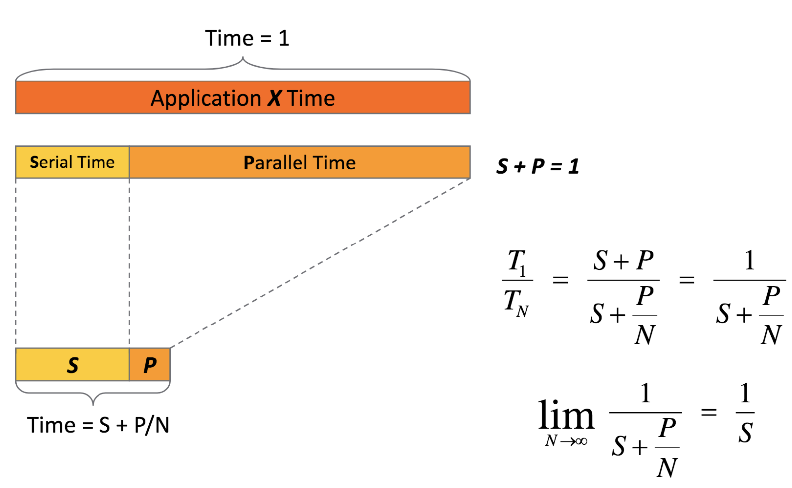
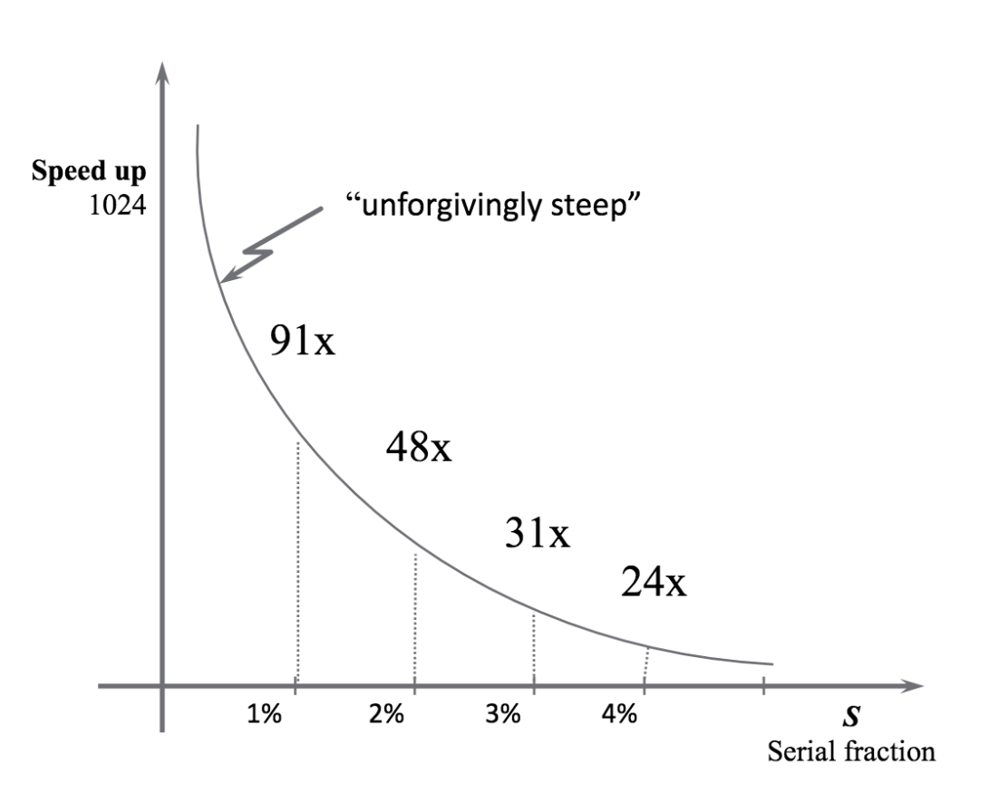
Amdahl’s Law
Parallelizing Python: Transitioning Beyond One Core. Research Computing Club.
https://github.com/UW-HPC/Parallelizing-Python-Workshop/blob/master/lectures/ParallelizationFundamentals.pdf

Slide 11
How do I make my MD simulation parallel?
mpirun -n 56 -genv OMP_NUM_THREADS 4 cp2k.psmp -i md.inp –o md.out
mpirun: Tells the computer to execute program in parallel using MPI
-n 56: Number of MPI ranks
-genv OMP_NUM_THREADS 4: Number of OpenMP threads per MPI rank
cp2k.psmp: Program that is getting executing
-i md.inp: Input file
-o md.out: Output file

Slide 12
Scaling Simulations
Computational resources are finite!
Design your large production runs to be efficient, not fast!
Unless you have a deadline coming up, like a conference in mid March and your results still aren’t complete…
Which point should you choose?
A: Best choice, most efficient
B: Maybe if you have a very hard deadline
C: Literally never, wtf?
D: Only if you own the nodes and like burning money
ns/day
A
B
C
D
Number of Cores

Slide 13
More cores
1% speed-up
my simulation

Slide 14
Basic Hyak Commands
Terminology:
Node: A single computer, which contains a CPU, RAM, and local storage (and maybe a GPU)
Login Node: Node that you connect to when connecting to Hyak. Has internet connection, but is NOT meant for any CPU intensive processes. Purely for interacting with compute nodes.
Compute Node: Node that runs CPU intensive jobs. No internet.
Allocation [-A]: Group of nodes. Typically name of node owner, e.g., pfaendtner
Partition [-p]: Subgroup of nodes within an allocation, there may only be one, in which case: partition == allocation

Slide 15
Basic Hyak Commands
Checking Node Statuses:
hyakalloc <partition>
Lists all currently running jobs and shows how many nodes are available
Does not show any jobs waiting in queue
squeue -p <partition>
Lists all currently running jobs
Shows full queue of jobs that may be waiting to run
sinfo -p <partition>
Lists node names and their statuses (e.g., idle, busy, draining, down, etc.)

Slide 16
Basic Hyak Commands
Handling Jobs:
sbatch job.slurm
Submits a slurm script that contains job settings
scancel <job_id>
Cancels job with <job_id>
srun …
Calls for an interactive node

Slide 17
Helpful Aliases
alias me=“squeue -u <netid>”
alias prg=“hyakalloc pfaendtner”
alias stf=“hyakalloc stf”
alias prgq=“squeue -p pfaendtner”
alias stfq=“squeue -p stf”
alias build=“srun -p build --time=2:00:00 --mem=10G --pty /bin/bash -l”
alias int=“alias interactive="srun --ntasks 1 --constraint=broadwell --mem=20GB -p pfaendtner -A pfaendtner --time=2:00:00 --pty /bin/bash"”
--constraint=cascadelake for 40 nodes
Two ways to exhaust a node: 1) cores, 2) memory

Slide 18
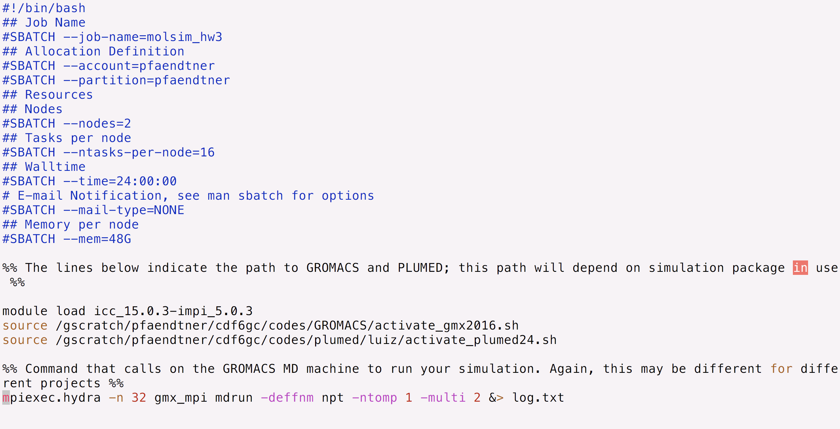
Job submission script

Slide 19
Few Tricks
vi ~/.ssh/config
For ikt:
Host hyak ikt.uw.edu
User <UW NetID>
HostName ikt2.hyak.uw.edu
ControlPath ~/.ssh/master-%r@%h:%p
ControlMaster auto
ControlPersist yes
ForwardX11 yes
ForwardX11Trusted yes
Compression yes
Protocol 2
For mox:
Host mox mox.uw.edu
User <UW NetID>
HostName mox.hyak.uw.edu
ControlPath ~/.ssh/master-%r@%h:%p
ControlMaster auto
ControlPersist yes
ForwardX11 yes
ForwardX11Trusted yes
Compression yes
Protocol 2
Open ~/.bash_profile
alias mox='ssh -Y mox'
alias ikt='ssh -Y ikt'

Slide 20
#SBATCH --nodes=2
#SBATCH --ntasks=32
mpiexec.hydra -n 32 gmx_mpi mdrun -deffnm npt -ntomp 1 -multi 2
#SBATCH --nodes=2
#SBATCH –ntasks-per-node=16
mpiexec.hydra -n 32 gmx_mpi mdrun -deffnm npt -ntomp 1 -multi 2

Slide 21
Time for the Jupyter Notebook!

